Slide 1




Microprocessor & Embedded System
Project title – Arduino Uno based Smart Home Automation System
Team Members -
Supervised By –
Nirjhor Tahmidur Rouf
Lecturer ,
Department of EEE

Slide 2
Table of Contents
Introduction
Literature Review
Methodology & Modeling
Cost analysis
Results and Discussion
Conclusion and future endeavors
References

Slide 3
INTRODUCTION
Background of Study:
Smart home technology is becoming increasingly popular and is becoming a major part of our lives. There are many advantages to using this type of technology, such as convenience, energy savings, and security. One of the key components of a smart home is the ability to control devices remotely via Bluetooth. Arduino is a great platform to use for creating a smart home system, as it is an open-source platform that is relatively easy to use and provides a wide range of features.
Motivation:
The motivation behind using an Arduino based Bluetooth smart home system is to provide an easy and convenient way to control devices in a home remotely. This could be used to automate lights, thermostat, window blinds, and other appliances. Additionally, this system could be used to automate a water pump, so that it can be controlled automatically to turn the pump on and off as needed. This would save energy and water, as well as provide convenience. Additionally, this system could be used to provide security, as it would allow for remote monitoring of the home, and could also be used to trigger alarms or disable access to certain areas of the home.

Slide 4
Project Objectives:
Develop a prototype of an Arduino-based Bluetooth-controlled smart home system.
Design an Arduino-based system for controlling home appliances using a smartphone.
Integrate a Bluetooth module for wireless communication between the user's smartphone and the Arduino-based system.
Implement a user-friendly interface for controlling the home appliances from the user's smartphone.
Test the performance of the system in various scenarios.
Design an Arduino-based system for automatic water pump control.
Develop an interface to track and monitor the water pump operation in real-time.
Integrate the system with sensors to detect water level and control the pump accordingly.
Test the system for accuracy and performance under different conditions.
Develop a comprehensive presentation to describe the working of the Arduino-based Bluetooth-controlled smart home system and the automatic water pump control system.

Slide 5
Brief outline of the Presentation
I. Introduction -
Overview of project
Benefits of project
II. Design of Arduino based Bluetooth control smart home & Automatic water pump -
Overview of Arduino
Overview of Bluetooth technology
Overview of Smart Home
Overview of Automatic Water Pump
III. Implementation of Arduino based Bluetooth control smart home & Automatic water pump -
Smart Home Programming
Automatic Water Pump Programming
IV. Results -
Results of Arduino programming
Results of Bluetooth programming
Results of Smart Home programming
Results of Automatic Water Pump programming
V. Conclusion -
Summary of results
Future enhancements

Slide 6
Literature Review
For our project research we have selected 5 published project related published journal for the literature review.
“Bluetooth-Based Smart Home Automation System” by E. A. Aborh, J. S. K. Adade, S. S. Adade and A. R. Tetteh (2018).
This paper presents a smart home automation system based on Bluetooth. The system is designed to provide security, comfort and convenience. It uses a Bluetooth module and Arduino Nano to control the devices in the home. The system is able to detect motion with a PIR sensor, and it can also be used to control appliances such as lights, fans, and air conditioning. The system can be accessed remotely using a smartphone.
“Design and Implementation of Arduino-Based Automated Water Pump System” by A. P. O. Oni, O. D. A. Adegboye and O. A. Olaniyi (2019).
This paper presents the design and implementation of an automated water pump system based on Arduino. The system is designed to monitor the water level in tanks and to automatically turn on and off the water pump based on the level of water. A PIR sensor is used to detect motion and to activate the water pump. The system is designed to be user-friendly and cost-effective.
“Bluetooth Controlled Automatic Water Pump System” by M. J. Z. Zulkifli, M. S. Z. Zulkifli and S. A. L. Hamzah (2020).
This paper presents a Bluetooth-controlled automatic water pump system. The system is designed to allow users to control the water pump remotely using a smartphone. The system uses an Arduino microcontroller, a Bluetooth module, and an ultrasonic sensor to measure the water level. The system is user-friendly and cost-effective.

Slide 7
Literature Review
“Smart Home Automation Using Arduino and Bluetooth” by A. M. M. Ramadhan, M. A. Rahman and M. A. M. Rahman (2021).
This paper presents a smart home automation system using Arduino and Bluetooth. The system is designed to be user-friendly and cost-effective. It uses an Arduino microcontroller and a Bluetooth module to control the devices in the home. The system is able to detect motion with a PIR sensor, and it can also be used to control appliances such as lights, fans, and air conditioning. The system can be accessed remotely using a smartphone.
“Design and Development of an Automatic Water Pump Control System using Arduino” by S. K. M. S. K. U. S. J. A. A. De Silva and W. M. B. W. K. Bandara (2022).
This paper presents the design and development of an automatic water pump control system using Arduino. The system is designed to monitor the water level in tanks and to automatically turn on and off the water pump based on the level of water. An ultrasonic sensor is used to measure the water level, and activate the water pump when needs. The system is designed to be user-friendly and cost-effective.

Slide 8
Methodology & Modeling
Smart Home Control System
A smart home control system is a technology that allows users to remotely control and monitor their home's appliances, security, and other systems from a single device or platform.
The system uses sensors, smart devices, and Bluetooth connectivity to provide real-time information and automated control of various home functions.
The benefits of a smart home control system include convenience, energy savings, improved security, and increased home value.
The system can be accessed from a variety of devices, including smartphones, tablets, and computers, and can be customized to suit individual preferences and needs.

Slide 9
Working principle of the proposed project
1. The project consists of two components: the Arduino board and the Bluetooth module.
2. The Arduino board is connected to the Bluetooth module and is programmed to receive commands from a smartphone or other device.
3. The user can use their smartphone to control various devices connected to the Arduino board, such as lights, fans, and other appliances in the home.
4. The user can also set up an automatic water pump system that can be controlled with the Arduino board.
5. The Arduino board receives the commands from the Bluetooth module, and then sends the commands to the water pump.
6. The water pump then pumps the water from the source to its designated destination, according to the commands received from the Arduino board.
7. This allows the user to control the water pump from their smartphone, and also allows for automated water pumping.

Slide 10
Process of Work
1. Gather Requirements - The first step is to gather the requirements of the project. This includes understanding the scope of the project, the objectives, and the expected outcome.
2. Design the System - After understanding the requirements, the next step is to design the system. This includes selecting the right hardware and software components for the project.
3. Build the System - After selecting the components, the next step is to build the system. This involves programming the Arduino board, connecting the Bluetooth module and other components, and testing the system.
4. Install the System - Once the system is built, the next step is to install it in the home. This involves connecting the system to the power supply and setting up the sensors.
5. Test the System - After installation, the system has to be tested to ensure that it works correctly. This involves connecting the system to a smartphone and testing the functions.
6. Monitor the System - After testing, the system has to be monitored to ensure that it is working correctly. This involves monitoring the sensors and checking the water pump.
7. Maintain the System - The system needs to be maintained to ensure that it is working correctly. This involves checking the sensors and the water pump regularly and making sure that all components are in working order.
8. Upgrade the System - If necessary, the system can be upgraded to add new features or improve existing features. This involves changing the programming and connecting new components.

Slide 11
Arduino Uno
HC-05 Bluetooth Module
4 Channel & 1 Channel Relay Module
Light
Fan
Door Motor
Breadboard
6V DC Battery
HC-SR04 Ultrasonic Sensor
Water Pump
Potentiometer
Jumper Wires
Description of the Components

Slide 12
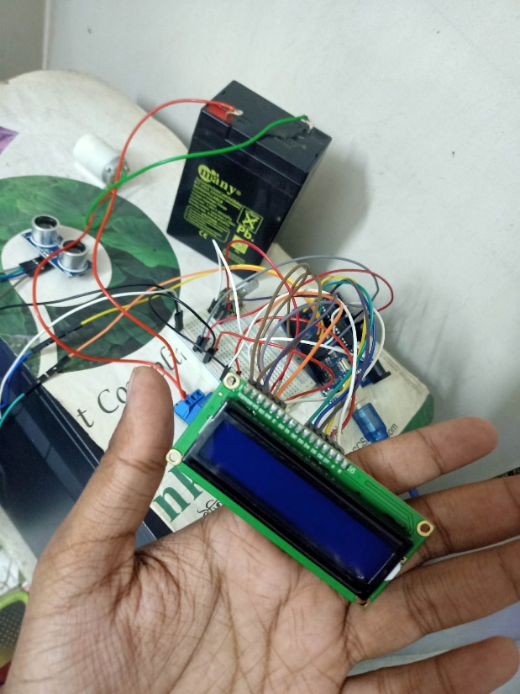
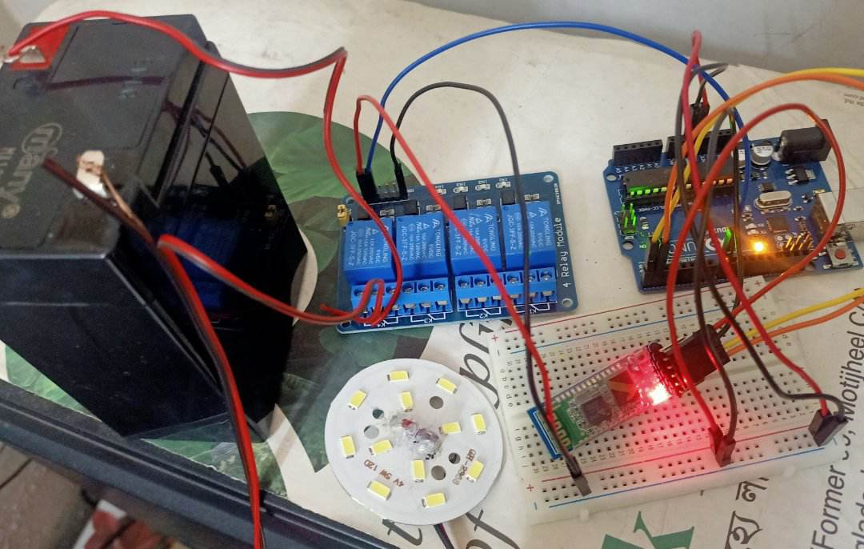
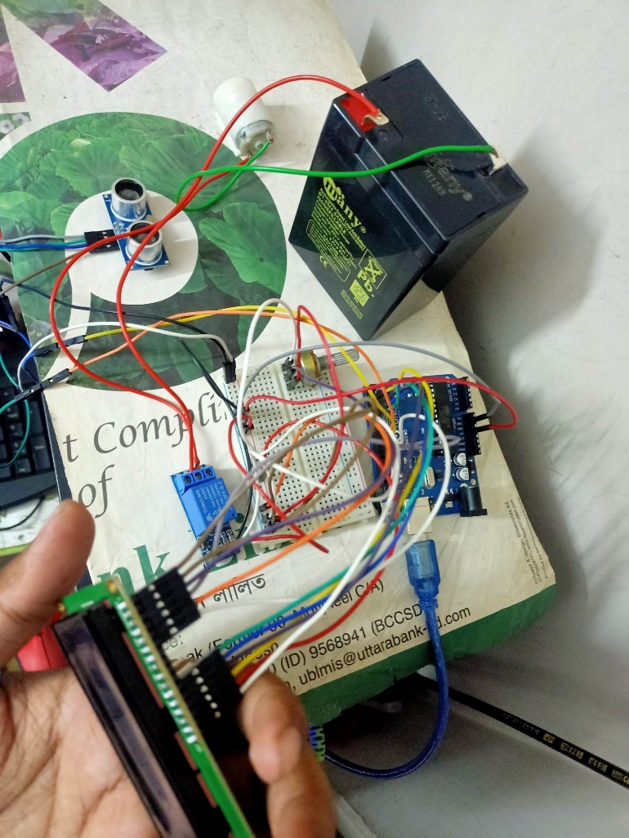
Implementation of the project
Automatic water
motor pump
Bluetooth Control Smart Automation

Slide 13
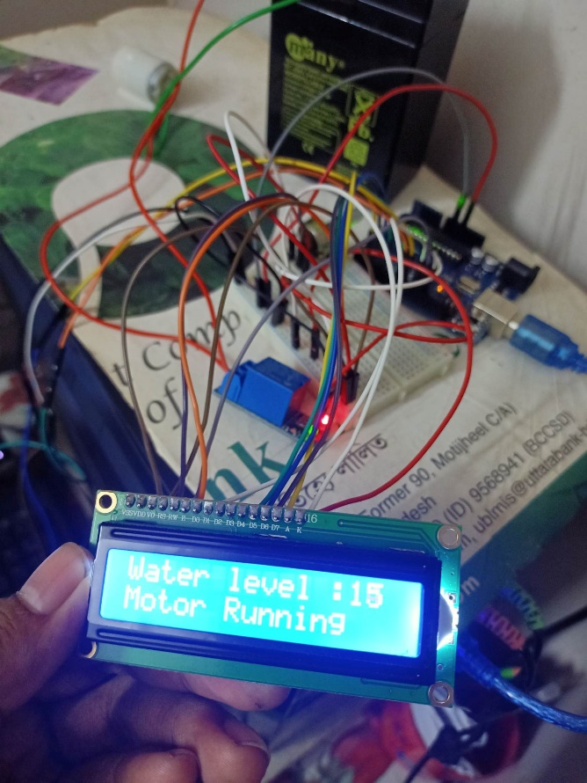
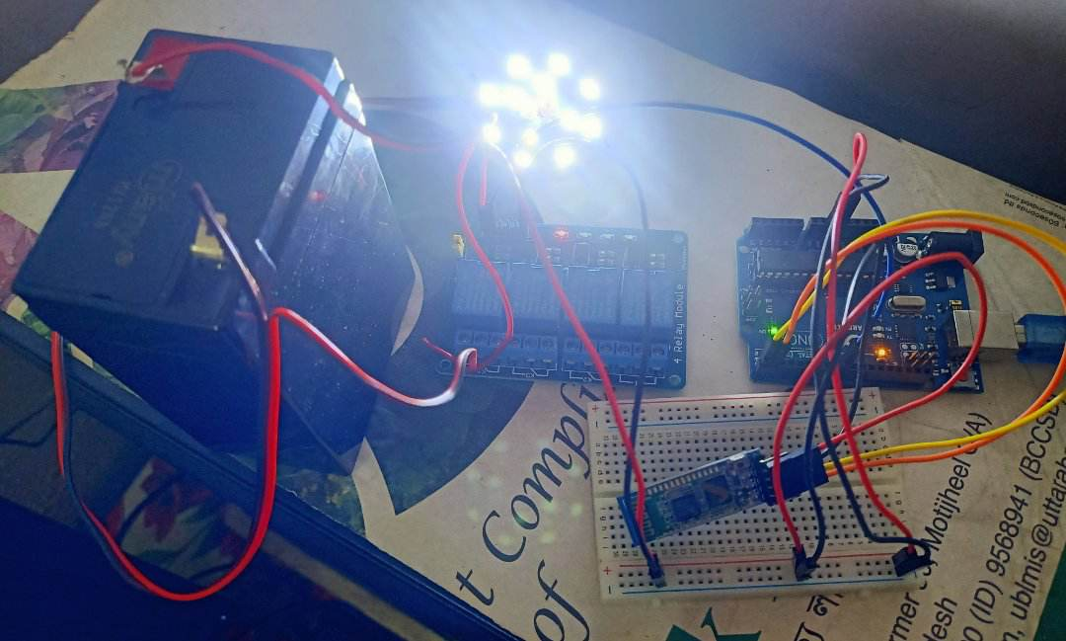
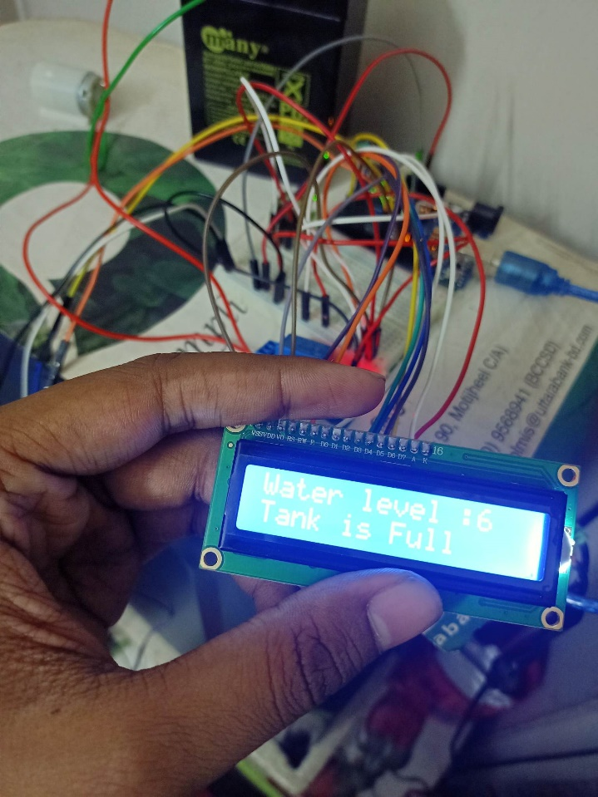
Test/Experimental Setup
Bluetooth Control Home Automation
Automatic water motor pump

Slide 14
Cost Analysis
Cost of Arduino: For this project, you will need to purchase an Arduino board, depending on the model which typically costs around 1000-1200 tk.
Cost of Bluetooth Module: You will also need to purchase a Bluetooth module, which typically costs around 450-500 tk.
Cost of Sensors & display: In order to make the project “smart”, you will need to purchase sensors such as Ultrasonic sensor which can cost around 150-200tk & LCD display which can cost around 300-350tk, depends on its model.
Cost of Relays: You will also need to purchase relays to control the appliances connected to the Arduino, which can cost around 500tk each.
Cost of Wiring: Wiring will also be necessary for this project, and depending on the complexity of the project, it can cost anywhere from 100-150 tk.
Cost of Water Pump: You will need to purchase a water pump to be controlled by the Arduino, which can cost around 120-150
Cost of Power Source: You will also need to purchase a power source, such as a battery, which can cost around 800-1000tk
Overall, the cost of the Arduino based smart home automation system can range from 3500-4000tk, depending on the components you choose to purchase.

Slide 15
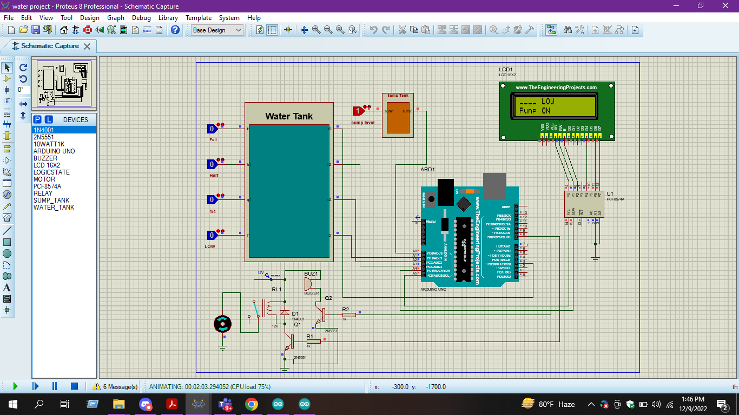


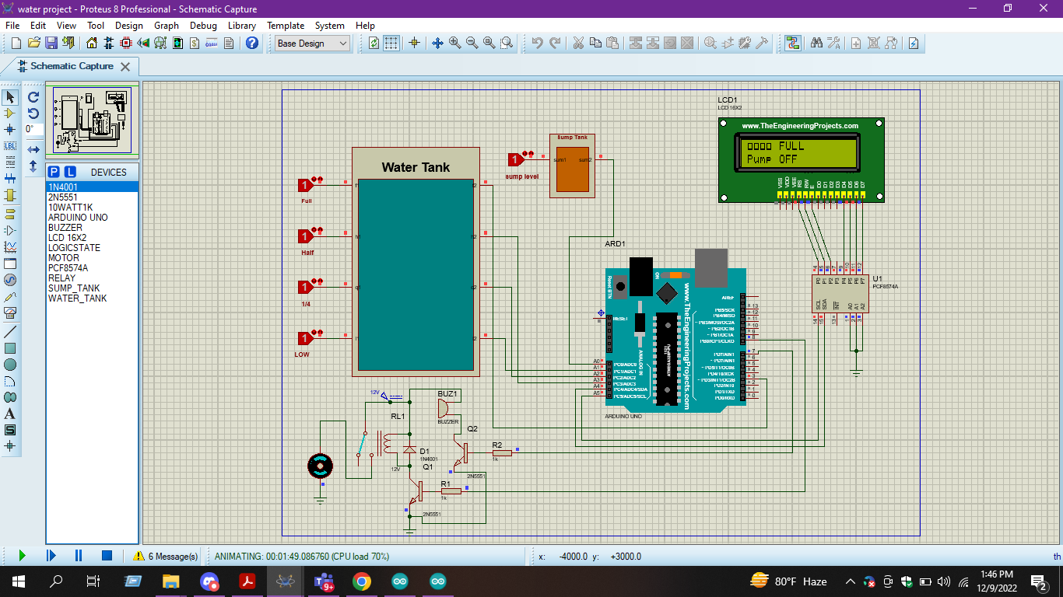
Results and Discussion
SIMULATION OF AUTOMATIC WATER WAER PUMP
Low water level & pump will be on
Half filled motor & pump on
¼ of water motor is filled
Water motor is Full & pump will be off

Slide 16
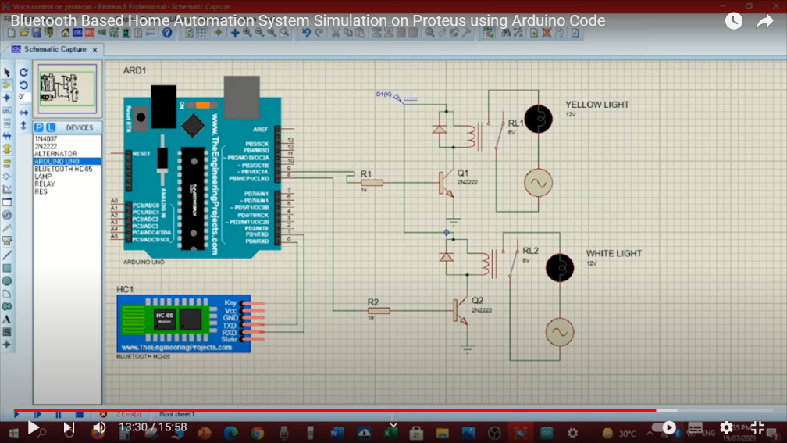
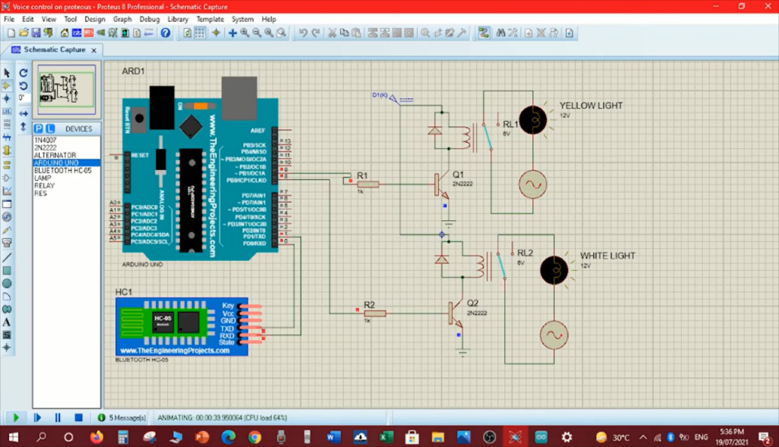

SIMULATION OF HOME AUTOMATION
ALL LIGHTS ARE OFF
BOTH LIGHTS ARE ON
YELLOW LIGHT IS ON

Slide 17
Measured response/Experimental results
The Arduino can be used to remotely operate many appliances in a smart house using Bluetooth technology Any alterations to the home environment can be detected using the Arduino to generate feedback or alarms. The Arduino may be used to precisely and accurately regulate a number of appliances in a home.
Water flow in a residence can be controlled with an automatic water pump. and flow rate can be configured to change according to demand.
When the water level is too low, the pump can be utilized to detect it and turn off automatically. In this way it can save energy and cut down on water waste.

Slide 18
Comparison between numerical and experimental results
Numerical Results of Bluetooth Controlled Smart Home based on Arduino and Automatic Water Pump:
Arduino can be used to control Bluetooth-enabled home equipment.
Experimental Results of Arduino-based Bluetooth Control Smart Home and Automatic Water Pump:
The Arduino can be used to remotely operate many appliances in a smart house using Bluetooth technology The Arduino can be used to control multiple devices in a home with accuracy and precision.
Water flow in a residence can be controlled with an automatic water pump. and flow rate can be configured to change according to demand. When water level is too low, the pump can be utilized to detect it and turn on automatically. This way it can save energy and cut down on water waste.
A home's water flow can be controlled by an automatic water pump and can be configured to change according to demand.
The pump can be utilized to save energy and cut down on water waste.
Arduino could be programmed to automate processes like lighting, temperature management, and security system control and Multiple devices in a home can be controlled by an effective and dependable system built with an Arduino.
The Arduino may be used to precisely and accurately regulate a number of appliances in a home.

Slide 19
Limitations in the project
In this project we can also control our automated house using voice control.
The water motor system that we have used that can be also control by voice instead of automatic system
Room temperature detector can be use which can turn on either ac or heater depending on the temperature

Slide 20
Conclusion and future endeavors
By attaching test appliances to the home automation system and effectively controlling the appliances with a wireless mobile device, the system has been experimentally demonstrated to operate well. The components communicate well with one another, and we can turn on and off our appliances up to 10 meters away using an Android phone.
The Bluetooth client was successfully tested on a multitude of different mobile phones from different manufacturers.
a low-cost home automation system
Conclusion
Future Endeavors
In future we can develop this project further .we can add more feature which can be controlled by voice like the water motor system and also the full automation system using voice controller.

Slide 21
References
Ragunathan, S., & Srivastava, A. (2018). Arduino Based Home Automation Using Bluetooth. International Journal of Advanced Research in Computer Science and Electronics Engineering, 7(2), 579-582.
Mishra, S., & Choudhury, S. (2019). Arduino based wireless control of home appliances, International Journal of Engineering and Advanced Technology, 8(6), 581-585.
Anand, B., & Kumar, S. (2020). Home Automation Using Arduino and Bluetooth. International Journal of Engineering and Advanced Technology, 9(4), 594-598.
Al-Shahwan, M., & Al-Omari, M. (2020). Design and control of home automation system using Arduino, Journal of Electronic Science and Technology, 18(2), 246-256.
Khan, K., & Kumar, S. (2020). Automatic water pump control system using Arduino, International Journal of Engineering and Advanced Technology, 9(5), 599-602.
Kumar, S. & Shrivastava, R. (2021). Arduino Based Home Automation Using Bluetooth Communication. International Journal of Research in Electronics, Mechanical and Computing, 1(1), 1-8.
Tiwari, A., & Pandey, A. (2022). Automatic water pump control system using Arduino, International Journal of Engineering and Advanced Technology, 11(3), 603-607.

Slide 22


